Slide 1
Devops tools

Slide 2
jenkins
Jenkins is an open-source automation tool.
It is mostly used for Continuous Integration (CI) and Continuous Delivery (CD).
In simple words: Jenkins helps you automatically build, test, and deploy your software.
Example: 👉 You write code → Push to GitHub → Jenkins automatically builds & tests → Deploys to server.
Think of Jenkins like a robot manager:
Developer writes code and uploads (push) to GitHub/GitLab/Bitbucket.
Jenkins watches for changes.
When changes happen, Jenkins pulls the code, builds it, tests it, and (if successful) sends it to a server or container (deploy).
This whole process is called CI/CD (Continuous Integration & Continuous Delivery/Deployment).

Slide 3
Why Use Jenkins?
✅ Saves time (no need to do everything manually) ✅ Reduces errors (automated process is more reliable) ✅ Easy to integrate with tools (Git, Maven, Docker, Kubernetes, etc.) ✅ Supports plugins (extra features)
Jenkins Basic Concepts
Job / Project → A task (e.g., build and test code).
Build → The execution of a job.
Node / Agent → A machine where jobs run.
Pipeline → Scripted steps (build → test → deploy).
Plugin → Add-ons to extend Jenkins.

Slide 4
First Job in Jenkins
Open Jenkins Dashboard → Click "New Item".
Enter a name → Select "Freestyle project" → OK.
Under Source Code Management, choose Git and add repo URL.
Under Build Steps, add "Execute Shell" (Linux) or "Execute Windows Batch Command". Example:
echo "Hello Jenkins!"
Save → Click Build Now.
See the console output → You’ll see "Hello Jenkins!" 🎉

Slide 5
jenkins Pipeline (Basic)
Jenkins Pipeline (or simply "Pipeline" with a capital "P") is a suite of plugins which supports implementing and integrating continuous delivery pipelines into Jenkins.
A continuous delivery (CD) pipeline is an automated expression of your process for getting software from version control right through to your users and customers. Every change to your software (committed in source control) goes through a complex process on its way to being released. This process involves building the software in a reliable and repeatable manner, as well as progressing the built software (called a "build") through multiple stages of testing and deployment.

Slide 6
Jenkins Real-Life Use Cases
Auto-build when code is pushed to GitHub.
Run automated test cases.
Deploy applications to servers (Tomcat, Docker, Kubernetes).
Schedule jobs (nightly builds, backups).

Slide 7
Jenkins architecture
Jenkins Master (Controller) → Brain of Jenkins. It manages jobs, schedules builds, distributes tasks.
Agents (Nodes/Slaves) → Machines where jobs actually run.
Plugins → Add features like Git integration, Docker build, Slack notifications.
Jobs → The tasks Jenkins does (build, test, deploy).
Pipelines → Step-by-step scripts that describe the job.

Slide 8
Jenkins architecture
Code pushed to GitHub.
Git plugin in Jenkins detects change.
Jenkins pulls code → builds it (using Maven/Gradle/NPM).
Runs tests (JUnit/Selenium).
If success → deploy to server (Tomcat, Docker, Kubernetes).
Sends notification (Slack/Email).

Slide 9
Types of Jenkins Jobs
Freestyle Project – Simple, point-and-click configuration. (Good for beginners).
Pipeline – Scripted in Jenkinsfile (better for automation and teams).
Multibranch Pipeline – Handles multiple branches (e.g., dev, QA, prod) automatically.
Folder – Organize jobs in folders.

Slide 10
Jenkins dashboard
Dashboard → List of jobs.
Build Queue → Shows waiting jobs.
Build Executor Status → Shows which agent is running what.
Job Page → Configuration, Build History, Console Output.

Slide 11
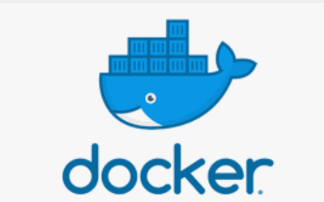
docker
Docker is an open platform for developing, shipping, and running applications. Docker enables you to separate your applications from your infrastructure so you can deliver software quickly. With Docker, you can manage your infrastructure in the same ways you manage your applications. By taking advantage of Docker's methodologies for shipping, testing, and deploying code, you can significantly reduce the delay between writing code and running it in production.

Slide 12
Docker platform
Docker provides the ability to package and run an application in a loosely isolated environment called a container. The isolation and security lets you run many containers simultaneously on a given host. Containers are lightweight and contain everything needed to run the application, so you don't need to rely on what's installed on the host. You can share containers while you work, and be sure that everyone you share with gets the same container that works in the same way.
Docker provides tooling and a platform to manage the lifecycle of your containers:
Develop your application and its supporting components using containers.
The container becomes the unit for distributing and testing your application.
When you're ready, deploy your application into your production environment, as a container or an orchestrated service. This works the same whether your production environment is a local data center, a cloud provider, or a hybrid of the two.

Slide 13
Docker architecture
Docker uses a client-server architecture. The Docker client talks to the Docker daemon, which does the heavy lifting of building, running, and distributing your Docker containers. The Docker client and daemon can run on the same system, or you can connect a Docker client to a remote Docker daemon. The Docker client and daemon communicate using a REST API, over UNIX sockets or a network interface. Another Docker client is Docker Compose, that lets you work with applications consisting of a set of containers.

Slide 14
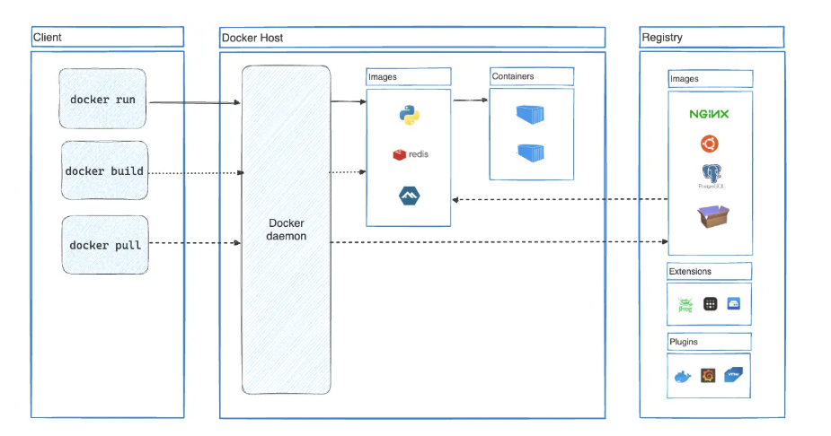
Docker architecture

Slide 15
Why use docker for e2e testing
E2E (End-to-End) testing means testing your entire application flow (frontend, backend, DB, services) as a real user would.
Problems without Docker:
Different machines have different environments.
Setting up databases, services, and dependencies is painful.
Cleanup after tests is messy.
With Docker:
You can spin up the whole environment in containers.
Run tests in an isolated, consistent setup.
Destroy it easily after testing (no pollution).

Slide 16
Core Docker Concepts
Image 🖼️ – A blueprint/template (like a recipe).
Example: python:3.11 → already has Python 3.11 installed.
Container 📦 – A running instance of an image (like cooking from the recipe).
Dockerfile 📜 – A set of instructions to build your own image.
Docker Compose 🔄 – A tool to run multiple containers together.
Example: Web App + Database + Message Queue in one YAML file.
Volumes 💾 – Store persistent data (like DB files) outside containers.
Networks 🌐 – Allow containers to talk to each other.

Slide 17
Docker in e2e testing
Networks 🌐 – Allow containers to talk to each other.
Write Dockerfile for frontend and backend.
Use docker-compose.yml to run frontend + backend + database together.
Add a test container that runs Selenium, Playwright, or Cypress tests.
Run docker-compose up --build → the whole system is up.
Tests run automatically → reports generated.
Run docker-compose down → everything stops & cleans up.

Slide 18
Benefit of docker
Consistency: Same setup in dev, test, and prod.
Isolation: No conflict with your laptop software.
Reproducibility: Anyone can rerun your tests easily.
Scalability: Run multiple environments in parallel.
Automation: Perfect for CI/CD pipelines.

Slide 19
kubernates
Kubernetes (K8s) is an open-source platform to manage containers (like Docker).
Think of it as the “operating system for the cloud”.
Instead of manually running your apps on servers, Kubernetes automates deployment, scaling, and management.
👉 Example: If you have a food delivery app, instead of putting all orders on one waiter (server), Kubernetes gives you many waiters (containers), manages them, and ensures no customer waits too long.

Slide 20
Why kubernates
🛠️ Automation – No manual server setup.
📦 Scalability – Add/remove containers as demand changes.
🛡️ Self-Healing – If a container crashes, Kubernetes restarts it.
🔄 Rolling Updates – Deploy new versions without downtime.
🌍 Portability – Works on any cloud (AWS, GCP, Azure, On-prem).

Slide 21
Kubernetes Key Concepts
🟦Pod
Smallest unit in K8s.
A pod = 1 or more containers running together.
👉 Example: Your app + a helper container (logging/monitoring).
Imagine a container box inside a shipyard. Each box (pod) holds an app (container).
🟩 Node
A machine (physical/virtual) where pods run. Managed by Kubernetes.
Two types of Nodes are there Master Node and Worker Node
Like in a company: Boss (Master) and Employees (Workers).

Slide 22
Kubernetes Key Concepts
🟨 Cluster
Group of nodes working together.
Controlled by a Master node (brain of Kubernetes).
👉 Think of it like a city where everything happens.
🟥 Deployment
A blueprint that tells Kubernetes how many pods to run, and which app to use.
Ensures correct number of pods are always running.
It also makes sure your app is always running, even if pods crash.
Like an order sheet in a factory → “Produce 5 boxes of this product.”

Slide 23
Kubernetes Key Concepts
🟧 Service
Gives a fixed address (IP/URL) to your pods.
Because pods can die/restart (new IPs), service ensures reliability.
Like a restaurant front desk → Customers don’t go to cooks directly, they ask the desk (service) to connect them.
🟪 Ingress
Handles external traffic (like load balancer + router).
Lets users access your app via https://myapp.com.
Like a security gate at the mall → decides who can enter and where they go.

Slide 24
Kubernates key concepts
🟫 ConfigMap & Secret
Store app configs and passwords.
ConfigMap = normal data, Secret = sensitive data.
Stores non-sensitive configurations (like URLs, settings).
👉 Like a notice board with instructions.

Slide 25
Kubernates workflow
You create Deployment (e.g., nginx-deployment.yaml).
Kubernetes schedules it to run on a Node.
It creates Pods.
You expose them using a Service.
If traffic increases → K8s adds more pods automatically.
If a pod crashes → K8s restarts it.

Slide 26
Mcq 1
Jenkins pipelines are defined using: a) Dockerfile b) Jenkinsfile c) YAML file d) XML file

Slide 27
Mcq 2
Which of these best describes Docker? a) A virtual machine manager b) A containerization platform c) A configuration management tool d) A CI/CD server

Slide 28
Mcq 3
The smallest deployable unit in Kubernetes is a: a) Pod b) Node c) Cluster d) Service

Slide 29
Mcq 4
Which command lists all running Docker containers? a) docker ps b) docker images c) docker list d) docker show

Slide 30
Mcq 5
Jenkins is primarily used for: a) Source code editing b) Continuous Integration/Delivery (CI/CD) c) Container orchestration d) Cloud hosting

Slide 31
Mcq 6
Which Kubernetes component manages the cluster state and API requests? a) kubelet b) kube-apiserver c) kube-proxy d) scheduler

Slide 32
Mcq 7
To build a Docker image, which command is used? a) docker run b) docker build c) docker create d) docker commit

Slide 33
Mcq 8
Kubernetes was originally developed by: a) Microsoft b) Google c) Amazon d) IBM

Slide 34
Mcq 9
Which file defines the instructions for building a Docker image? a) Makefile b) Dockerfile c) Jenkinsfile d) manifest.yaml

Slide 35
Mcq 10
Which plugin allows Jenkins to define CI/CD pipelines as code? a) Git Plugin b) Blue Ocean c) Pipeline Plugin d) Docker Plugin

Slide 36
Mcq 11
Jenkins is written in: a) Python b) Java c) Go d) Ruby

Slide 37
Mcq 12
Kubernetes helps in: a) Sending emails b) Orchestrating containers c) Writing code d) Building laptops

Slide 38
Mcq 13
The file used to build a Docker image is: a) Dockerfile b) Jenkinsfile c) package.json d) manifest.xml

Slide 39
Mcq 14
Jenkins jobs can be triggered by: a) Git commits b) Time schedules c) Manual click d) All of the above

Slide 40
Mcq 15
The running instance of a Docker image is called a: a) Container b) Pod c) Node d) Service

Slide 41
Mcq 16
Kubernetes clusters usually have two types of nodes: a) Master and Worker b) User and Admin c) Big and Small d) Pod and Service

Slide 42
Mcq 17
A Docker container shares the same: a) Host OS kernel b) Own operating system c) New VM every time d) Mobile emulator

Slide 43
Mcq 18
In Kubernetes, YAML files are used to: a) Watch movies b) Define objects like Pods and Services c) Install Jenkins d) Store passwords

Slide 44
Mcq 19
The correct flow in CI/CD with these tools is: a) Jenkins builds → Docker images → Kubernetes deploys b) Kubernetes builds → Jenkins deploys → Docker runs c) Docker builds → Jenkins deploys → Kubernetes makes images d) Jenkins deploys → Docker orchestrates → Kubernetes runs CI jobs

Slide 45
Mcq 20
Which Kubernetes object is responsible for load balancing and service discovery? a) Deployment b) ConfigMap c) Service d) ReplicaSet

